Slide 1
Learning Management System Selection Task Force
Report and Recommendation
2020-2021
San Ramon Valley Unified School District

Slide 2
Task Force Purpose:
Select a comprehensive Learning Management System for implementation in the 2021- 2022 school year.

Slide 3
Online software application which allows for:
Administration and delivery of course content and curriculum
Documentation and reporting of student progress
Collection and analysis of academic performance data and assessments
Assists and aids collaboration and communication among students, staff and parents
What is a Learning Management System?

Slide 4
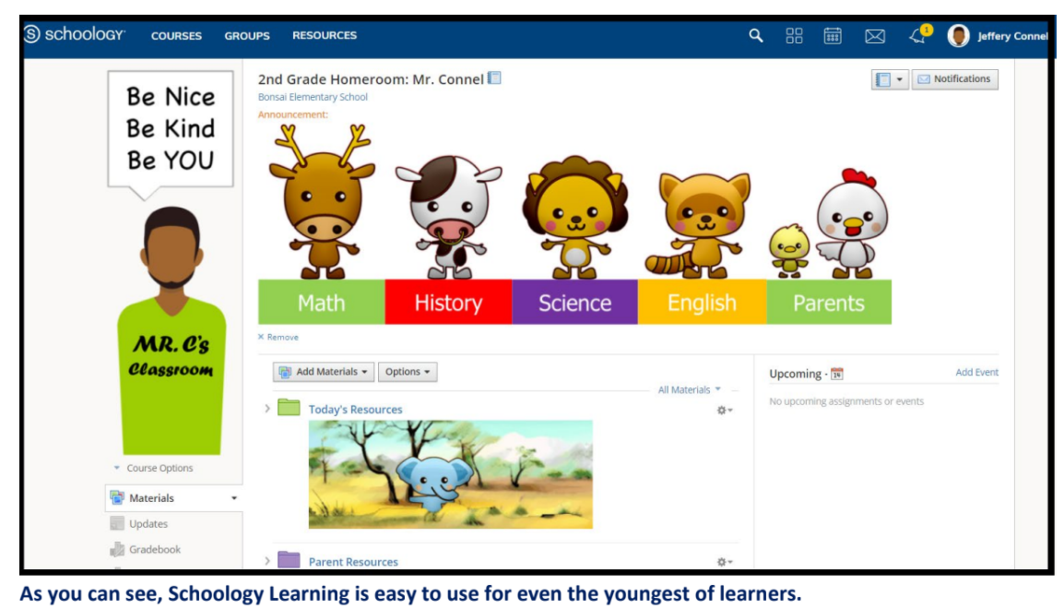

Slide 6
Committee Membership:
Approximately 60 Members
Staff chosen in collaboration with CSEA and SRVEA
Sites without representation were invited for the evaluation phase
Parents chosen by PTA, SRVEF and at-large interest
Administrators chosen on a voluntary basis
Membership consisted of:
Certificated Staff
Classified Staff
Site Administrators
Parents
Students

Slide 7
Background and Context:
2020-2021 School Year
SRVUSD decided to use Google Classroom and SeeSaw as our online learning platforms for the 2020-2021 school year
Recognition that we had the need for a comprehensive platform as we take the lessons of the pandemic into the future
Schoolloop kept as a tool for communicating grades and progress with students and families.
Task force created to recommend a more comprehensive learning management system
2021-2022 School Year
Training and implementation of new Learning Management System for SRVUSD for students, families and staff

Slide 8
Oct/Nov
Dec/Jan
Jan/Feb
Mar/Apr/May
Timeline
Vision building and
select key criteria; finalize criteria to be posted in RFP
Post RFP and
select platforms to test & evaluate
Test & evaluate platforms
Select final platform and begin implementation
Notes:
Must allow for flexibility due to unpredictable factors in the winter, changes to our schedules and remote learning

Slide 9
Building a Consensus Together
Our goal in decision making was to build a clear consensus
A transparent and collaborative process requiring compromise and flexibility.
If documentable consensus could not be achieved, a straight vote on the options would be the final decision

Slide 10
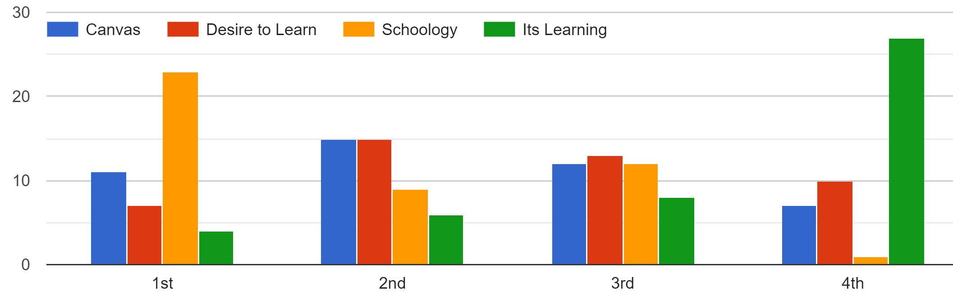
Initial Evaluation Data

Slide 11
Tabulated Rankings of Initial Evaluation
Low score is better. 1st place votes got 1pt. 4th place got 4pts.
Elementary
Platform | Points
Schoology | 18
Finalist # 2 | 28
Finalist # 3 | 28
Finalist # 4 | 36
Secondary
Platform | Points
Schoology | 49
Finalist # 2 | 61
Finalist # 3 | 68
Finalist # 4 | 92
Total
Platform | Points
Schoology | 81
Finalist # 2 | 105
Finalist # 3 | 116
Finalist # 4 | 148

Slide 12
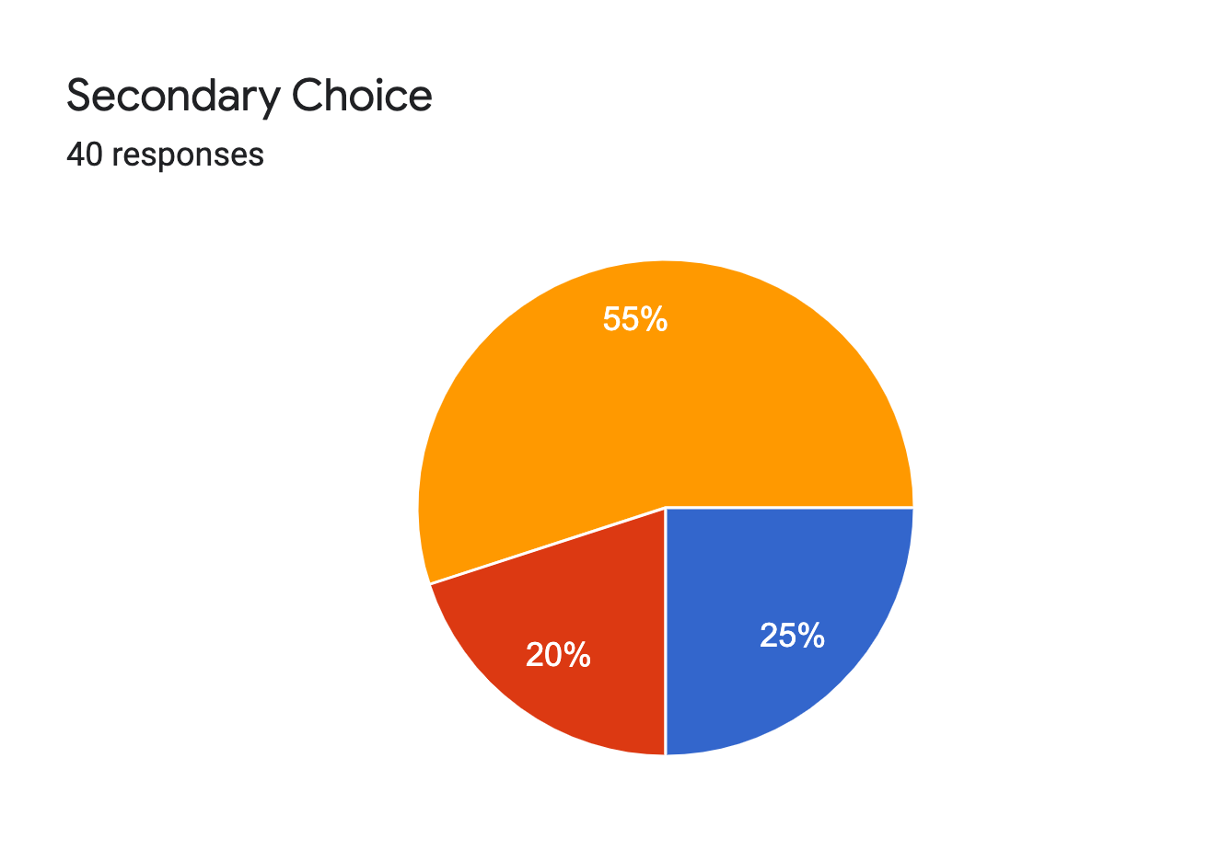
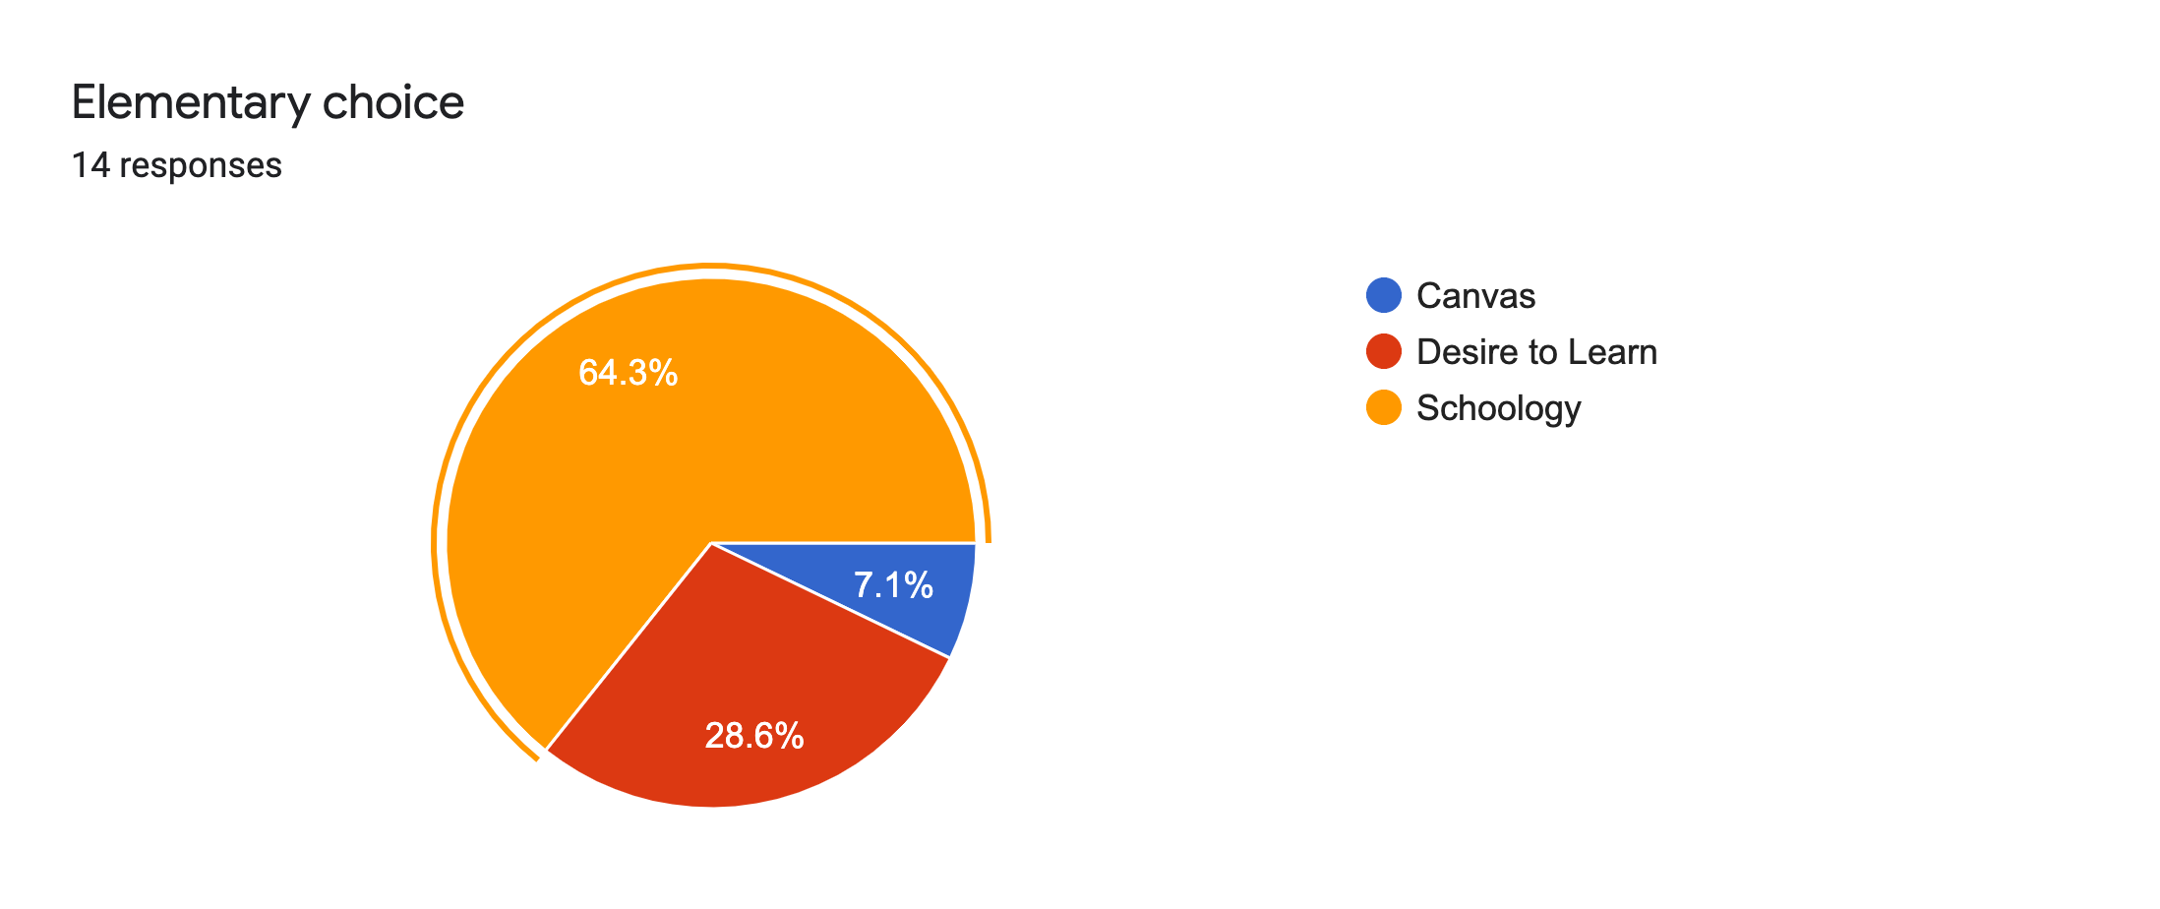
Final Selection Straw Poll Data

Slide 13
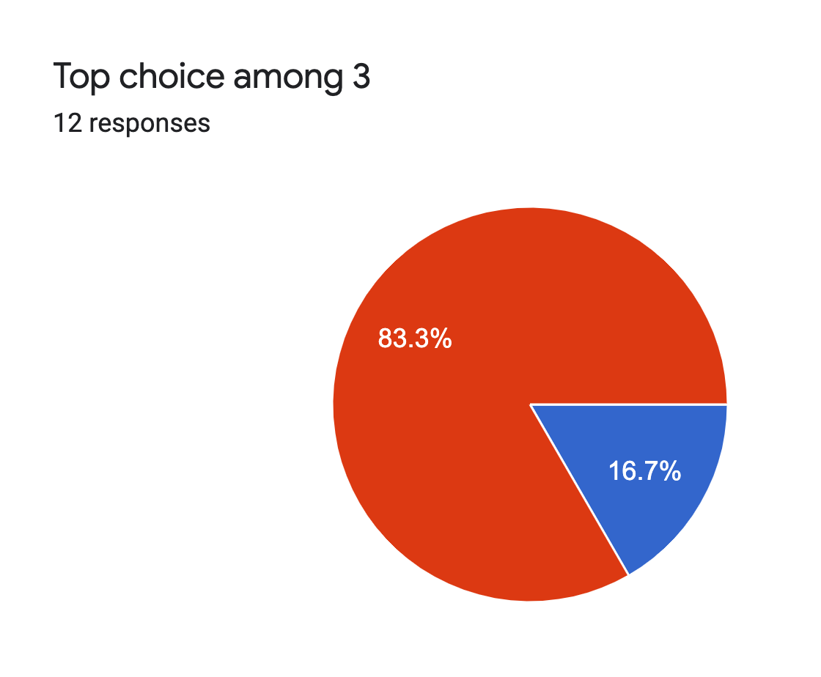
Elementary Final Poll
Top Choice Between Schoology and Finalist #2
Top Choice Between Schoology and Finalist #3

Slide 14
Elementary Consensus

Slide 15
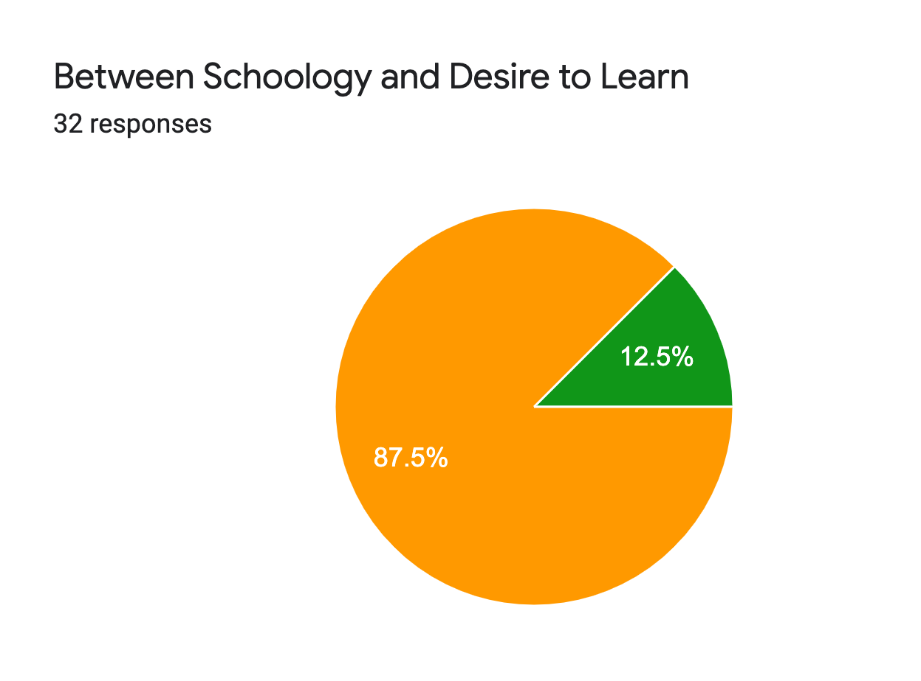
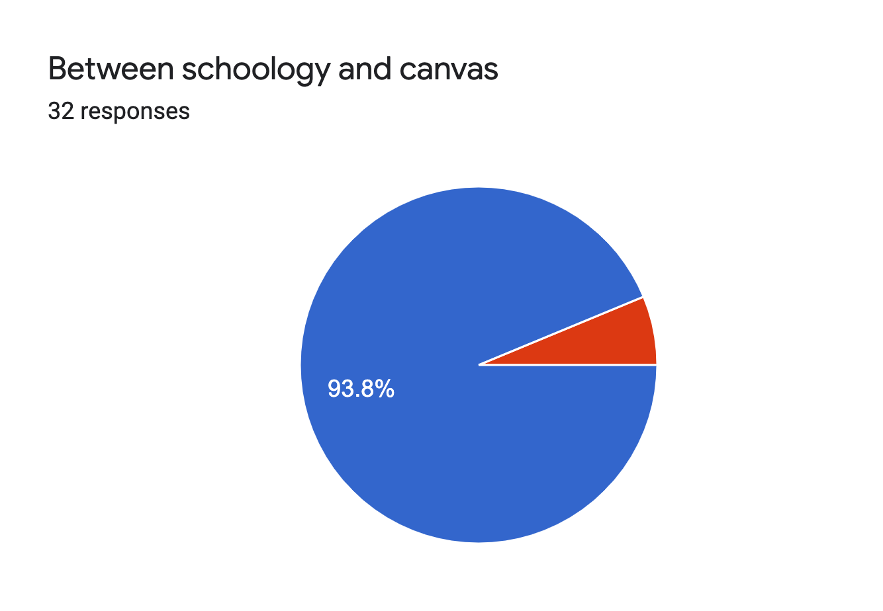
Secondary Final Poll
Finalist #2
Finalist #3

Slide 16
Secondary Consensus

Slide 17
Schoology: Advantages to SRVUSD
Met 168 of the 176 criteria set forth by the task force
User friendly interface requiring less upfront training for effective use
Gradebooks able to accommodate both standards-based and traditional grading methods
Content and course building seen as ‘seamless’ with access to district and site curriculum; teachers able to create individual and group assignments, meetings, discussion boards and assessments
Parents able to view work submission, teacher feedback, upcoming assignments and able to control settings of notifications
Interfaces well with Google Apps
Positive references from Modesto USD and Palo Alto USD

Slide 18
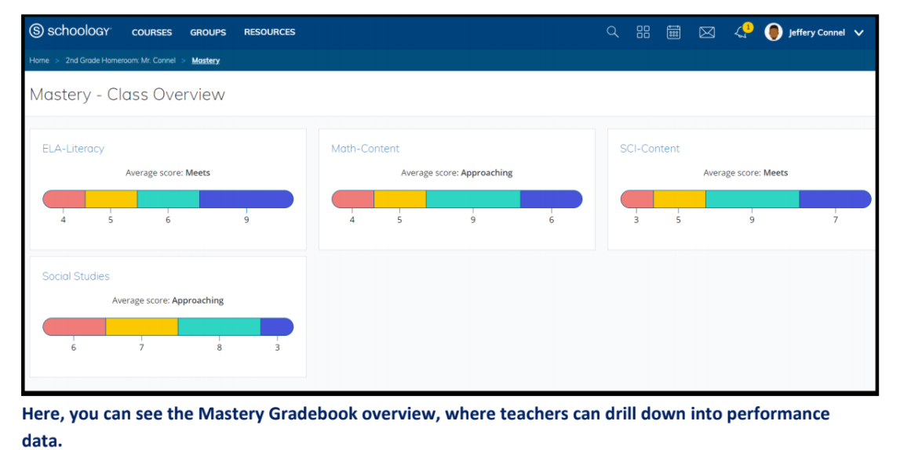
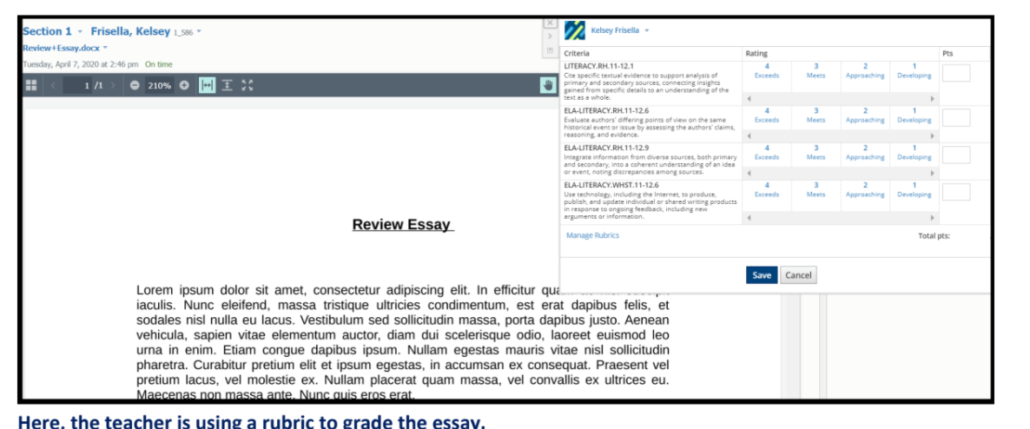

Slide 19
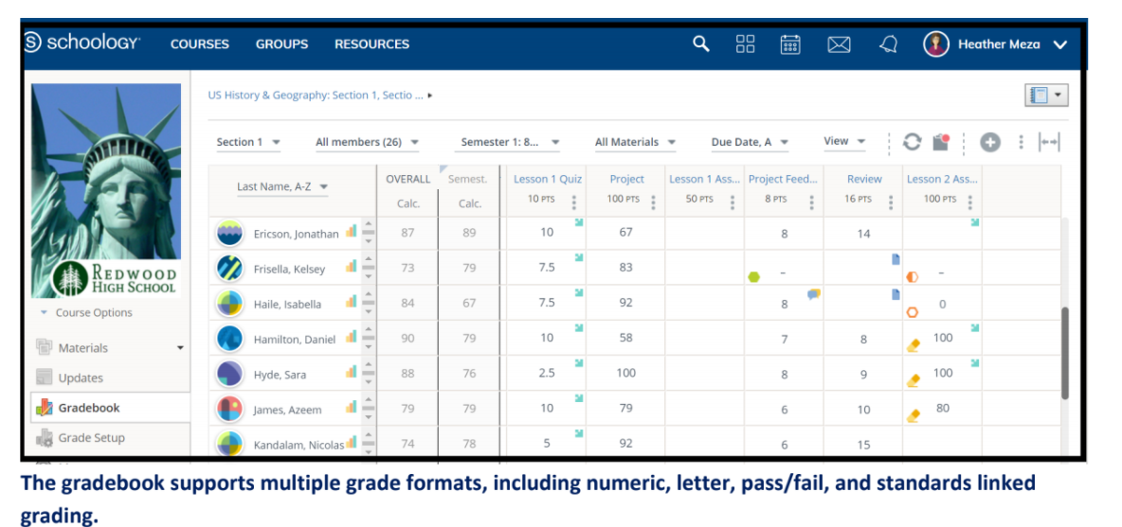

Slide 20
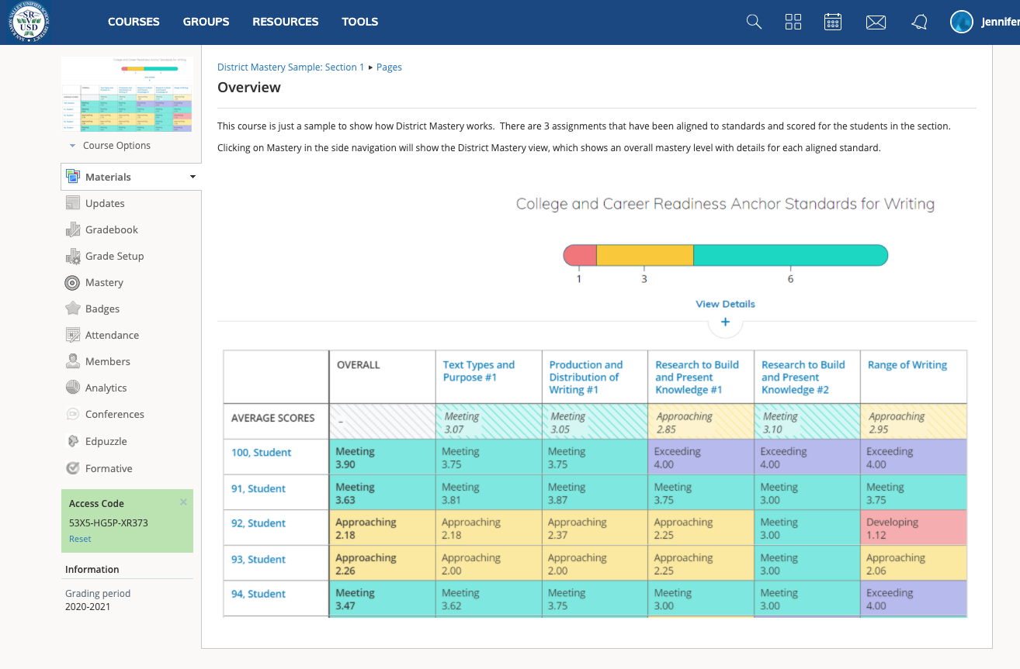
Mastery Based Gradebooks

Slide 21
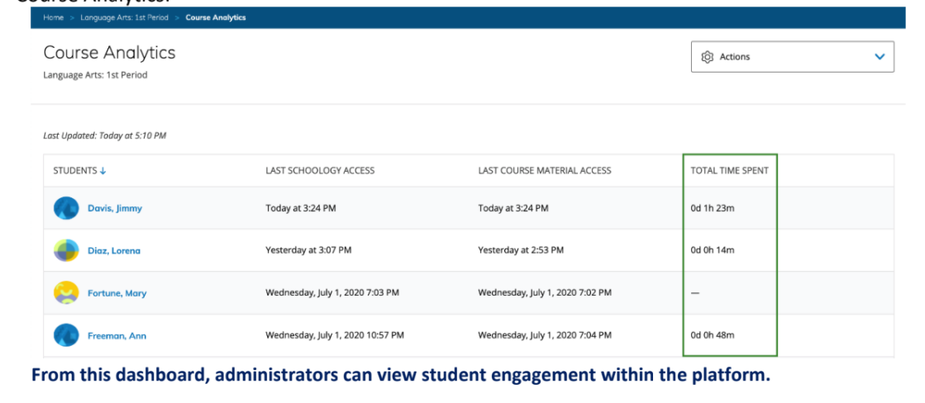

Slide 22
Learning Management Selection Task Force Recommendation:
The implementation of the Schoology LMS for use at both the Elementary and Secondary levels for the 2021- 2022 school year.

Slide 23
This decision required a tremendous amount of collaboration and work from the task force participants during an already difficult year. We wish to extend our gratitude to all participants for their many hours of work.
Sarah Acosta-Landry, Assistant Principal on Special Assignment
Christopher George, Director of Instruction
Jennifer Hunau, Coordinator
Gregory Pitzer, Director of Technology

